Slide 1
DIGITAL
CASH
Prof. Gokay Saldamli
Harika Reddy Billuri
Namratha Venkatesh Murthy
Neeraj Venugopal
Yashaswi Doddaveerappa

Slide 2
AGENDA
WHAT IS DIGITAL CASH
BASIC MODEL OF DIGITAL CASH
IMPLEMENTATION
PROPERTIES
PROTOCOL
CHALLENGES

Slide 3

WHAT IS DIGITAL CASH ??
Digital cash is a system of purchasing cash
credits in relatively small amounts, storing
the credits in your computer, and then
spending them when making electronic
purchases over the Internet

Slide 4

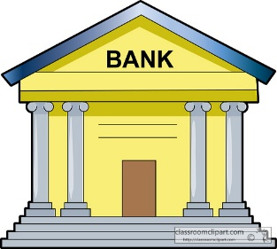
BASIC MODEL OF DIGITAL CASH
a Payer (P) or User.
a Payee (R), such as a merchant.
A financial network like a Bank.

Slide 5

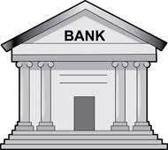

1. ALICE SEND UNSIGNED, BLINDED COINS TO THE BANK
2. BANK SIGNS COINS, SENDS THEM BACK. ALICE UNBLINDS THEM
ALICE
3. ALICE PAYS TO BOB
BOB
4. BOB VERIFIES WITH BANK
5. BOB DEPOSITS

Slide 6

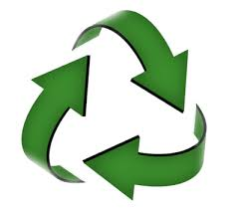


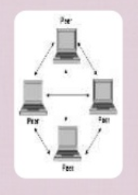
PROPERTIES OF DIGITAL CASH
SECURITY | REUSABLE | PORTABLE | ANONYMOUS | TWO-WAY PAYMENT

Slide 7
PROTOCOL IMPLEMENTED
Secret Splitting Protocol
Bit Commitment Protocol
Blind Signature Protocol

Slide 8

CHALLENGES
Synchronization between Banks.
Huge database for records.
Susceptible to hacking.

Slide 9
Conclusion
Digital cash promises to be a revolutionary method for conducting business.

Slide 10
THANK
YOU

